Slide 1

Basic Banking System:
Alliance Bank of India (Web App)
Created By:
Kumar Gaurav

Slide 2


Slide 3


Slide 4
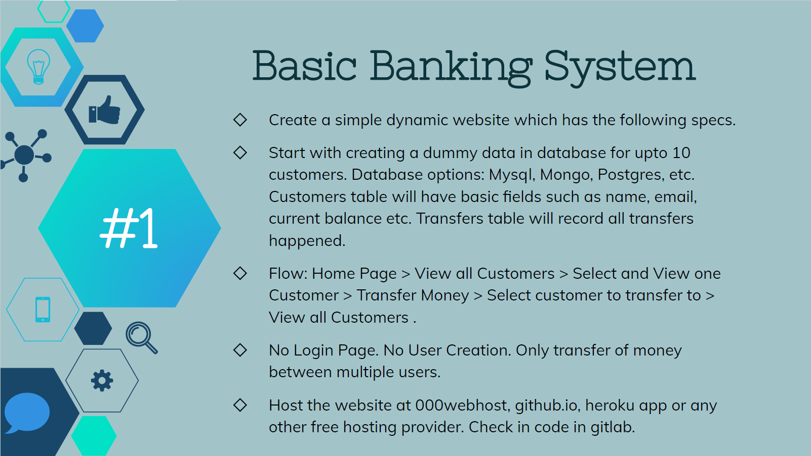

Slide 5
Thank You!

